Slide 1
ACTIVATION SOCIAL MEDIA
E-COMMERCE DIVISION

Slide 2
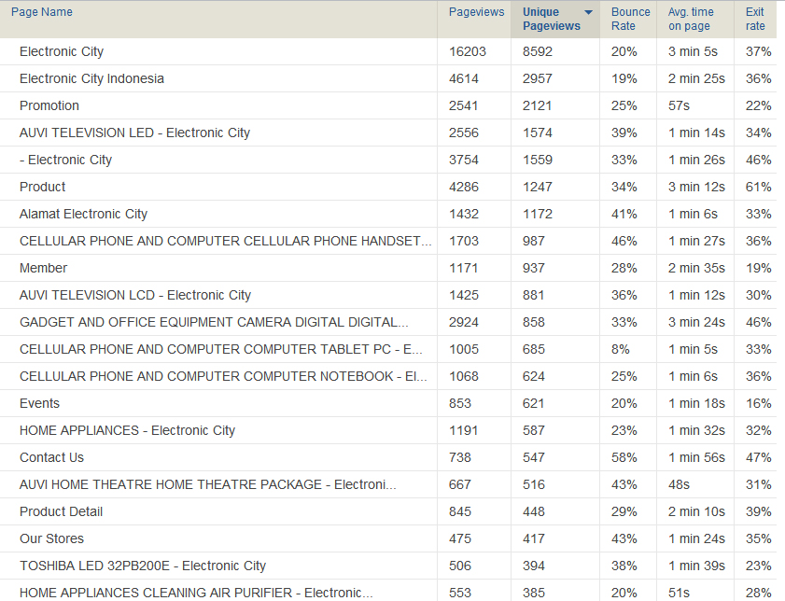

Slide 3
ACTIVATION 1
BLOGGERS
GET BLOGGERS COMMUNITY ON SPECIFIC CATEGORY
EVENT
BLOGGERS CONTEST FOR ELECTRONIC CITY REVIEWS
CATEGORY
GADGET
CAMERAS
AUVI
RULES
CREATE BLOG ABOUT ELECTRONIC CITY IN SPECIFIC CATEGORIES
PRIZES
ELECTRONIC STUFF
CONTRACT REVIEWER FOR ELECTRONIC CITY BLOG

Slide 4
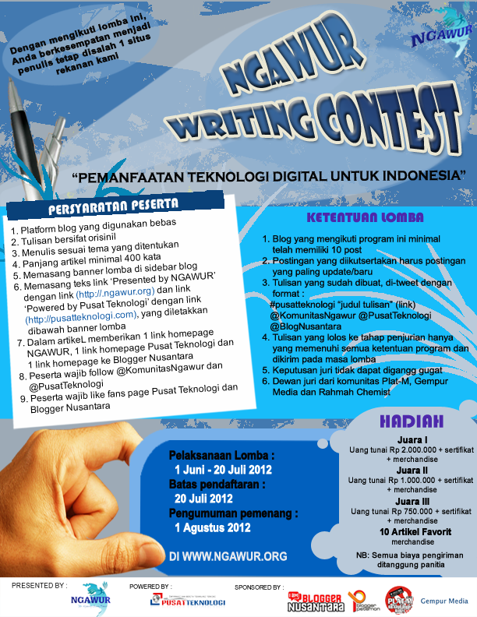
CONTEST EXAMPLE

Slide 5
ACTIVATION 2
CREATING SURVEY
SURVEY ABOUT OUR SERVICE
SURVEY ABOUT PAYMENT METHODS
SURVEY ABOUT STORES
SURVEY ABOUT WEBSTORES
PAYMENT METHOD
OBJECTIVES
CREATING OUR SERVICE BETTER FROM OUR CUSTOMERS INPUT

Slide 6
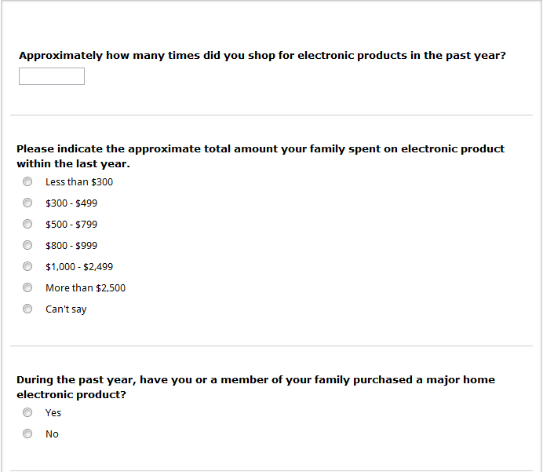
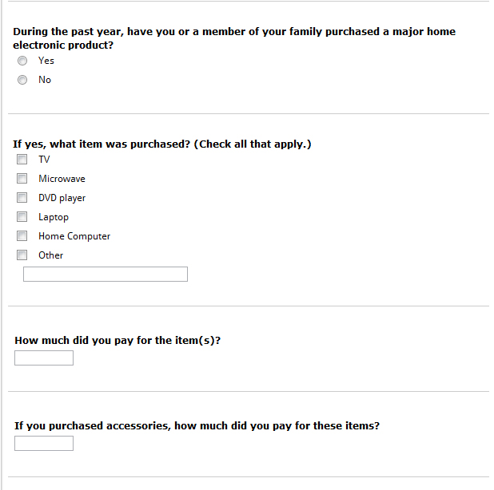
SURVEYS

Slide 7
ACTIVATION 3
GAMES
TEBAK GAMBAR
SUIT JEPANG
RULES
POINT BASE
MOST POINT IN THE END OF PERIOD, WIN

Slide 8
SUMMARY
ACTIVATION 1
Get community/follower/fans from bloggers that already have big community.
ACTIVATION 2
Improve our self with customers comment
Give us a scores on our service
Retain our community
ACTIVATION 3
Give some fun and prizes for our loyal customers/community.

Slide 9
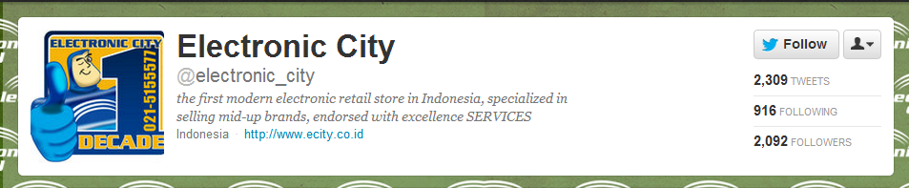
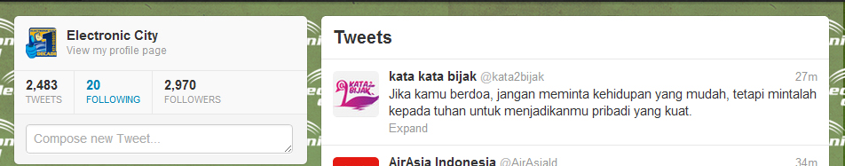
BEFORE
AFTER

Slide 10
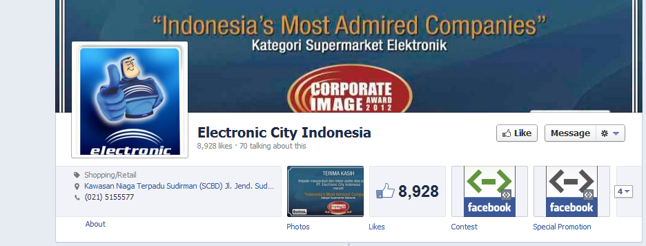
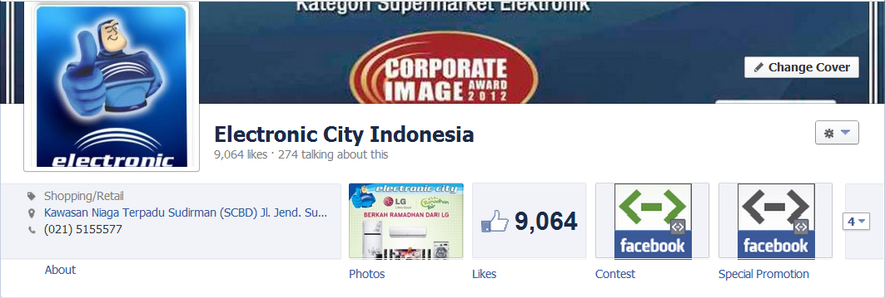
BEFORE
AFTER

Slide 11
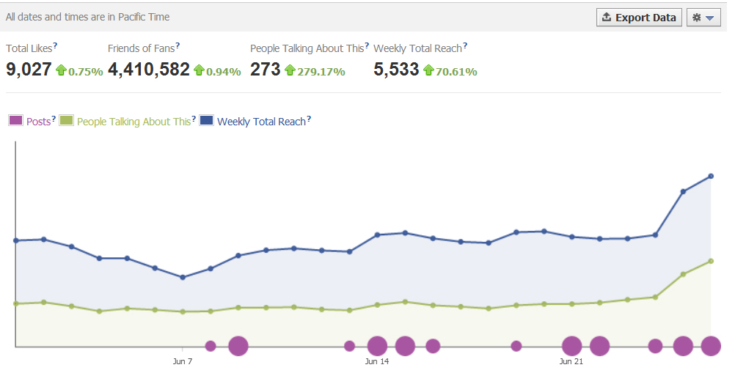

Slide 12
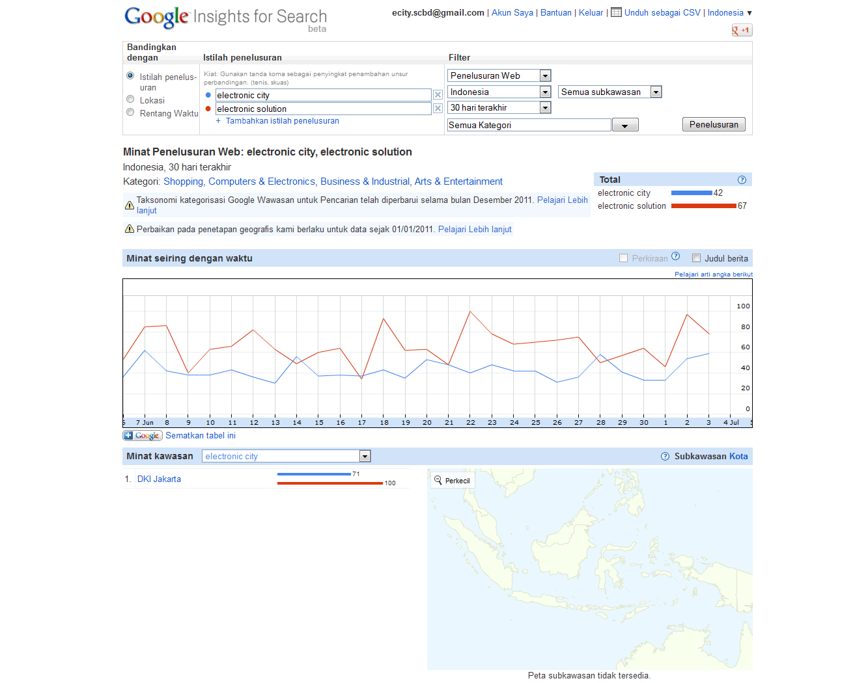

Slide 13
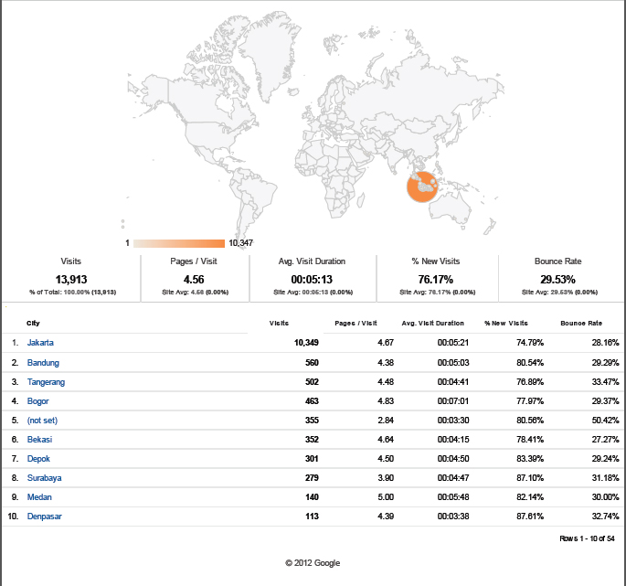

Slide 14
THANK YOU

